Slide 1
Chapter 6: Creational Design Patterns
Session III: Builder, Prototype, Singleton

Slide 2
Session’s Agenda
Creational Patterns in Detailed Design
Builder
  Code generator example
Prototype
  Character cloning example
Singleton
  Event manager example
What’s next…

Slide 3
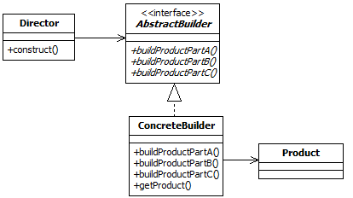
Builder Design Pattern
The Builder Design pattern is an object creational pattern that encapsulates both the creational process and the representation of product objects.
  Unlike the Abstract Factory, in which various product objects are created all at once, Builder allows clients to control the (multistep) creational process of a single product object, allowing them to dictate the creation of individual parts of the object at discrete points throughout software operations.
According to the GoF, the intent of the Builder is to [1]
  Separate the construction of a complex object from its representation so that the same construction process can create different representations.
These interface methods specify the multistep creational process for the Product!
This guy orchestrates the creational process!
Creator
Classes
Concrete Builders must provide implementation for creational interface functions!
Product
Class

Slide 4
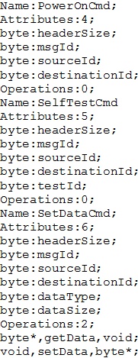
Builder Design Pattern Example
Consider a code generator:
  Code generated from an interface specification document (ICD) used to monitor and control custom developed hardware.
  Company sells hardware, but also includes library to monitor and control its hardware.
  Generator reads a text document containing information about a messaging specification. It then generates C++ classes that can be used to monitor and control hardware. This is also shipped to customers so that they can use the hardware easily.
  The ICD is quite complex, and customers are demanding support for other languages, such as Java and C#.
Java Code
IN
Code Generator
OUT
Open and read file
Find message name, attributes, operations
Generate language-specific code
Close file
C++ Code
Different representation!
C# Code
Same construction process!

Slide 5
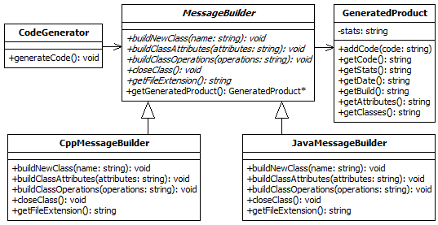
Builder Design Pattern Example
Abstract Builder
Director
Notice that we moved the getProduct (…)method one level up. This may not be possible in other problems!
Concrete Builders

Slide 6
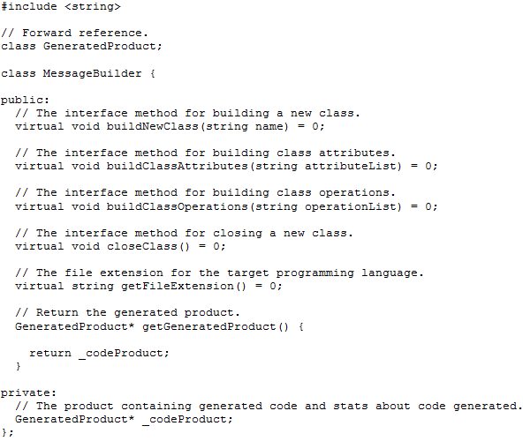
Builder Design Pattern Example
The Builder Interface for generating code!
The same steps used to create products in all target languages!

Slide 7
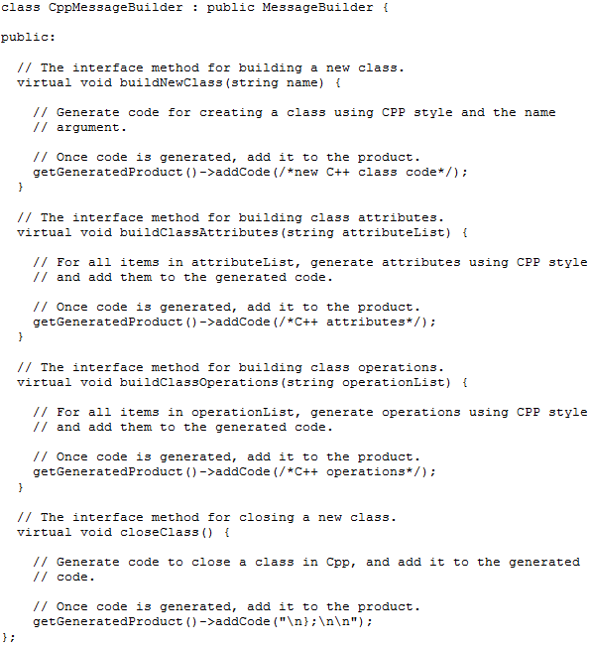
Builder Design Pattern Example
C++ Builder
Step 1
class MessageOne
{
Step 2
class MessageOne
{
private:
int attributeOne;
int attributeTwo;
Step 3
class MessageOne
{
private:
int attributeOne;
int attributeTwo;
public:
void setValueOne(unsigned char x);
Step 4
class MessageOne
{
private:
int attributeOne;
int attributeTwo;
public:
void setValueOne(unsigned char x);
};
C++ Product Created!

Slide 8
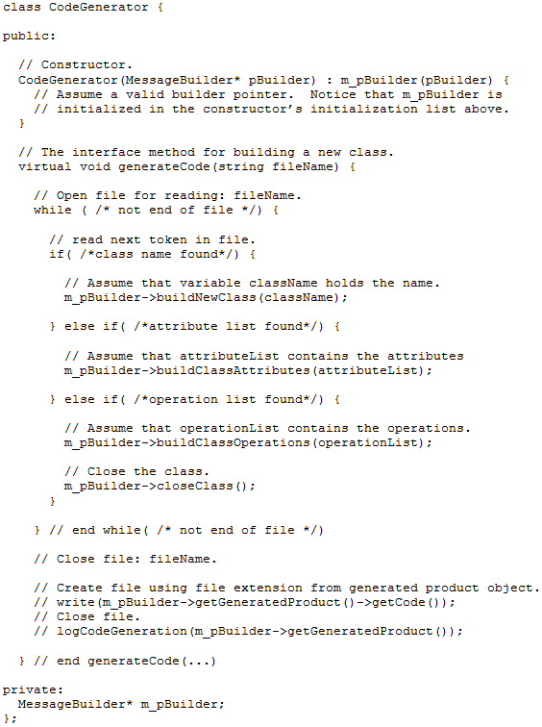
Builder Design Pattern Example
In the previous slide, we presented how a C++ message builder could be created.
Product representation, i.e., generated code, depends on the Builder passed in as parameter!
In similar fashion, C# or Java builders can be created.
The process used for identifying names, attributes, and operations in the ICD could be quite complex!
The same creational process is used for all target languages!
However, if we manage to separate this process from its ultimate product representation (e.g., java vs. c++ code), we can reuse it to generate these and other future products by extension and NOT modification!

Slide 9
Builder Design Pattern Example
Steps for designing using the Builder pattern:
  Identify and design the product class (e.g., GeneratedProduct)
  Identify the product’s creational process and algorithm, and design a class for its execution (e.g., CodeGenerator).
  Using the knowledge acquired from steps 1 and 2, design the builder interface, which specifies the parts that need to be created for the whole product to exist. These are captured as abstract interface methods that need to be implemented by derived concrete builders.
  Identify and design classes for the different representations of the product (e.g., CppMessageBuilder, JavaMessageBuilder, etc.)
The Builder provides the following benefits:
  Separates an object’s construction process from its representation; therefore future representations can be added easily to the software.
  Changes to existing representations can be made without modifying the code for the creational process.
  Provides finer control over the construction process so that objects can be created at discrete points in time, which differs from the Abstract Factory pattern.

Slide 10
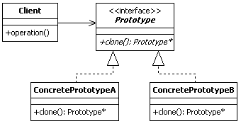
Prototype Design Pattern
The Prototype design pattern is a class creational pattern that allows clients to create duplicates of prototype objects at run-time without knowing the objects’ specific type.
According to the GoF, the intent of the prototype design pattern is to [1]
  Specify the kinds of objects to create using a prototypical instance, and create new objects by copying this prototype.
Derived classes must obey the prototype interface!
Clients use the prototype interface to create objects without knowing their specific types!
Both Product and Creator Classes

Slide 11
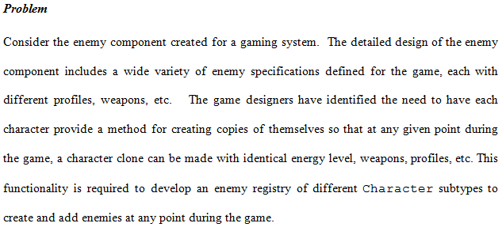
Prototype Design Pattern Example

Slide 12
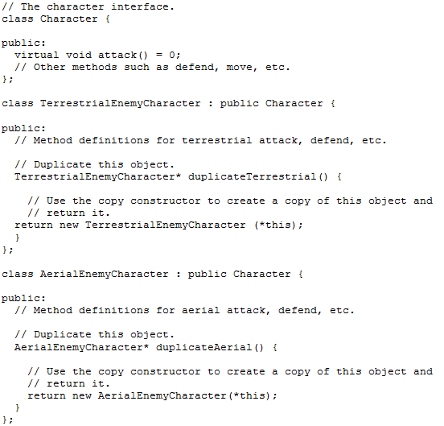
Prototype Design Pattern Example
Method to create copies of Terrestrial characters
Method to create copies of Aerial characters
Consider how client code would look like when programmed against this design…

Slide 13
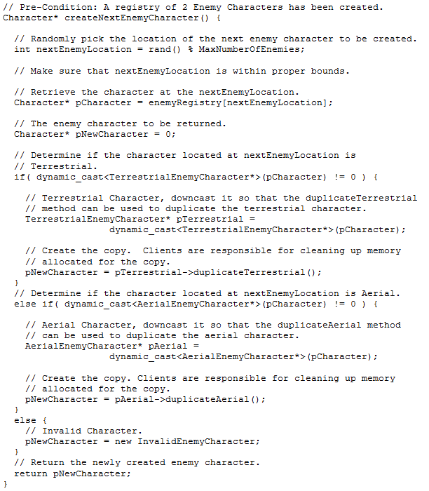
Prototype Design Pattern Example
Yikes!
What happens if we introduce a new character to the game?
This violates OCP!
Let’s see how we can improve things with the Prototype design pattern…

Slide 14
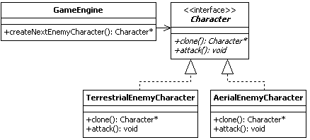
Prototype Design Pattern Example
Add the prototype clone interface method to the Character interface
The client can now rely on the clone interface to create Character objects, regardless of which Character subtype is actually active!
Concrete Characters must obey the Character interface!

Slide 15
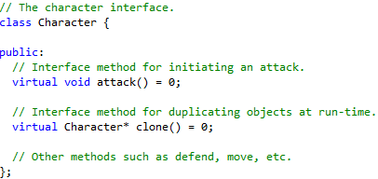
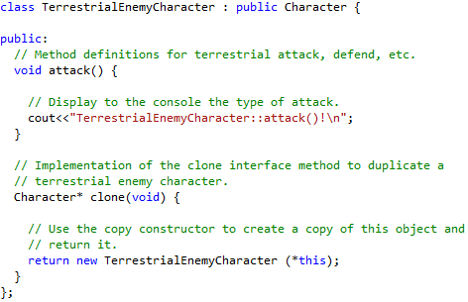
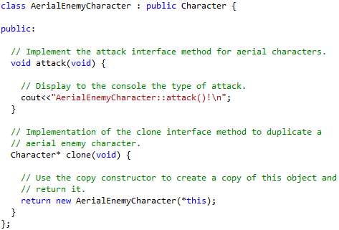
Prototype Design Pattern Example

Slide 16
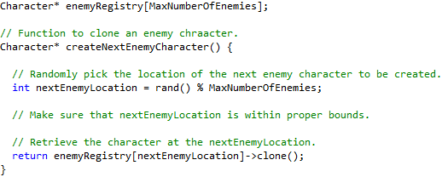
Prototype Design Pattern Example
We can now replace this with that!

Slide 17
Prototype Design Pattern Example
Steps to design using the Prototype design pattern include:
  Identify and design the common interface that needs duplication. As part of the interface, the clone method (or equivalent) needs to be specified.
  Identify and design concrete products, which realize the interface created in Step 1.
  For each concrete product created in Step 2, implement the clone method in terms of that particular concrete product.
Benefits of the Prototype design pattern include:
  Clients are shielded from knowing the internal structure of objects; therefore, adding products at runtime becomes easier. This reduces the client’s complexity.
  Reduced number of classes; instead of having two classes (i.e., creator and product classes), the prototype is both, therefore eliminating the need for one class for each product.

Slide 18
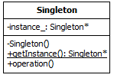
Singleton Design Pattern
The Singleton design pattern is an object creational design pattern used to prevent objects from being instantiated more than once in a running program.
According to the GoF, the intent of the Singleton is to [1]
  Ensure a class only has one instance, and provide a global point of access to it.
Private Constructor to restrict object instantiation
Private static instance
Public static getInstance() method to create and provide access to the one and only object instance

Slide 19
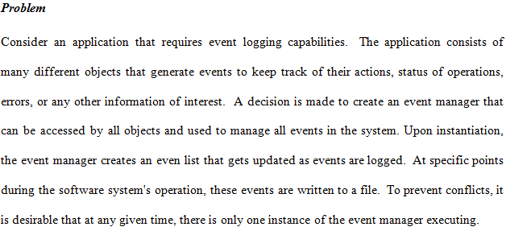
Singleton Design Pattern Example

Slide 20
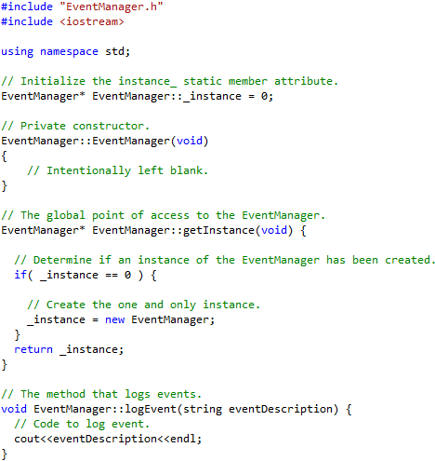
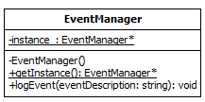
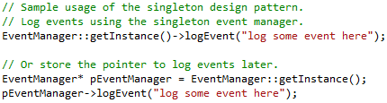
Singleton Design Pattern Example
Sample code to log events using the Singleton design pattern
Warning!
Singleton has been documented to cause memory leaks in multi-threaded environments!

Slide 21
Singleton Design Pattern Example
Steps to design using the Singleton design pattern:
  Set the visibility of the constructor to private
  Define a private static member attribute that can store a reference (i.e., a pointer) to the one instance of the singleton.
  Create a public static getInstance() method that can access the private constructor to instantiate one object of the singleton type and return it to clients.
Benefits of the Singleton design pattern include:
  It provides controlled access to single a single instance of a given type.
  It has reduced namespace since it provides an alternatives to global variables.
  It can be customized to permit a variable number of instances.

Slide 22
What’s Next…
In this session, we continued the discussion on creational design patterns, including:
  Builder
  Prototype
  Singleton
This finalizes the discussion on creational design patterns. In the next module, we will present structural and behavioral design patterns in detailed design. Specifically, we will cover:
  Adapter
  Composite
  Façade
  Iterator
  Observer

Slide 23
References
[1] Gamma, Erich, Richard Helm, Ralph Johnson, and John Vlissides. Design Patterns: Elements of Reusable Object-Oriented Software. Boston: Addison-Wesley, 1995.

